Slide 1
U.S Wind Power Market: Investment decision
WOW! Investment Committee
September 2023

Slide 2
US Wind Turbine Industry | focus and objectives
MN
Wind Turbine Market
Operators Analysis
Understanding Turbines
Future Outlook
Recommendation & Funding
Global market of wind energy
Current State of the energy and renewable energy market
Current State of the wind turbine market
Evolution of the wind turbine market
Understanding current players
Geographical presence of key players
Profitability of operators
Geographical distribution of plants in the US
Attributes of plants
Size
Capacity
Location
Trends in attributes of wind turbine:
Manufacturers
Capacity
Electricity Generation
Maintenance requirements
Dimensions
COP27
US National Renewable Energy Targets
Other policies and reforms
Recommendation of operators, dimensions and locations
Potential financier

Slide 3
Wind Turbine Market

Slide 4
PB
Wind Turbine Market | Global Market
Global Wind Turbine Market
Top Wind Producing Companies in 2021 | By Installed Wind Capacity (GW)
The global renewable energy market size was valued at $1.1 trillion (USD) in 2022 and has been projected to grow at 16.9% per year from 2023 to 2030.
The global wind energy market was valued at over $99.28 billion in 2021, behind the solar power and hydropower segments.
The US is the second largest generator of wind energy of installed wind turbine capacity in the world in 2021 at 132.7GW, behind China who are market leaders globally.
The US’s capacity is greater than the total of Germany, India and the UK.
More than 60,000 turbines are installed in the U.S., with cumulative capacity of 134.2 GW.
340
300
260
220
180
Installed Wind Capacity (GW)
140
134.4
100
60
20
14.3
China
U.S
Germany
India
UK
France
Brazil
Canada
Rest of the World

Slide 5
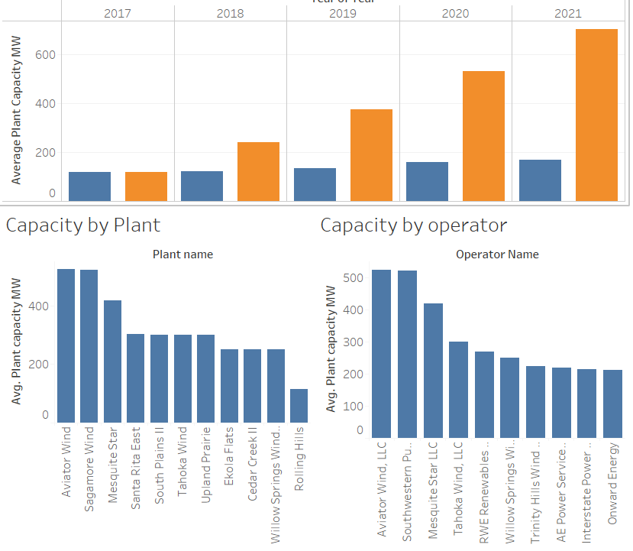
SL
US Wind Turbine Market | US Market
US Wind Turbine Market
Renewable Energy Sources | Net Generation (‘000 MWh)
As a result of current government policies and lower wind costs, the US has grown its wind capacity by an average growth rate of 11.3% from 2011 to 2021.
Wind energy currently generates over 9% of national electricity, and more than 50% in states such as Iowa and South Dakota.
In the US, Wind energy surpassed Conventional Hydroelectric as the leader in renewable energy source of energy generation in 2019 and has continued to increase year on year whilst Conventional Hydroelectric has gone on a decline in output.
Net Generation (‘000 MWh)
73,151
0
Wind
Solar Photovoltaic
Conventional Hydroelectric
Other
Notes:
When looking at the US wind Turbine market:
As a result of current government policies and lower wind costs, the US has grown its wind capacity by an average annual growth rate of 11.3% from 2011 to 2021.
Wind energy currently generates over 9% of national electricity, and more than 50% in states such as Iowa and South Dakota.
In the US, Wind energy surpassed Conventional Hydroelectric as the leader in renewable energy source in 2019 and has continued to increase year on year whilst Conventional Hydroelectric has gone on a decline in output.

Slide 6
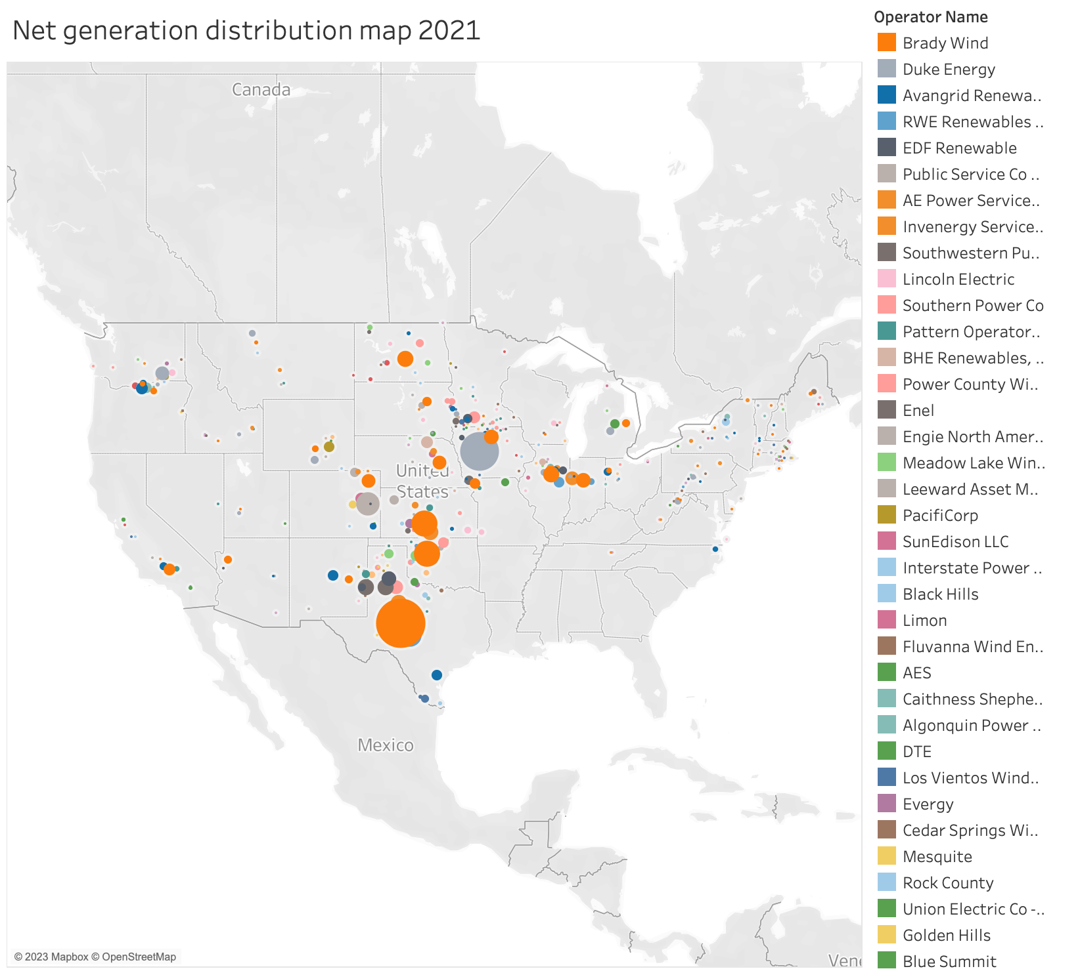
SL
Wind Turbine Market | US Market
Number of plants: 1,160
Total number of turbines: 73,009
Number of operators: 213
Total rated capacity: 129,944k MW
Total net generation in 2021: 36,688m MW
Notes:
Slide 6:
At a snapshot, there are:

Slide 7
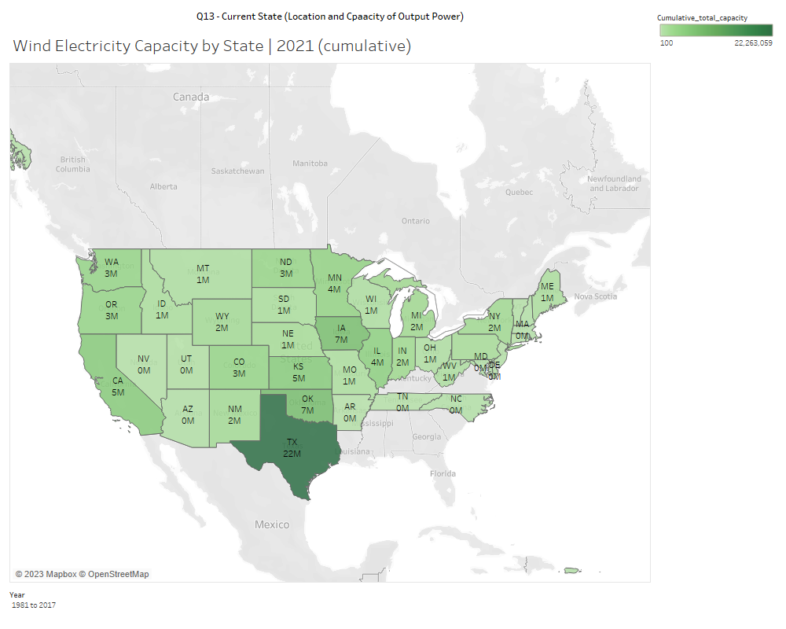


SL
Wind Turbine Market | US Market
US Wind Turbine Market | Turbine Capacity over time (kW)
Within the US, Texas has the highest electricity capacity by a significant margin out of all US states in 2021, this is approximately c. 34.6m kilowatts (kW).This is followed by Iowa at 12m kW
Texas has remained the state with the greatest additional electricity capacity for all years from 2017 to 2021.
It is also worth noting that the Midwest has the highest number of turbines. Texas has approx. 17,000 wind turbines and Oklahoma has approx. 4,900 wind turbines.
2017
2019
2021
Notes:
Slide 7:
Within the US, Texas has the highest electricity capacity by a significant margin out of all US states in 2021, this is approximately c. 34.6m kilowatts (kW). This is followed by Iowa at 12m kW
Texas has remained the state with the greatest additional electricity capacity for all years from 2017 to 2021.
It is also worth noting that the Midwest has the highest number of turbines. Texas has approx. 17,000 wind turbines and Oklahoma has approx. 4,900 wind turbines.

Slide 8
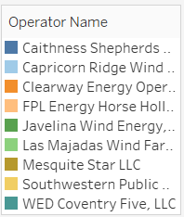
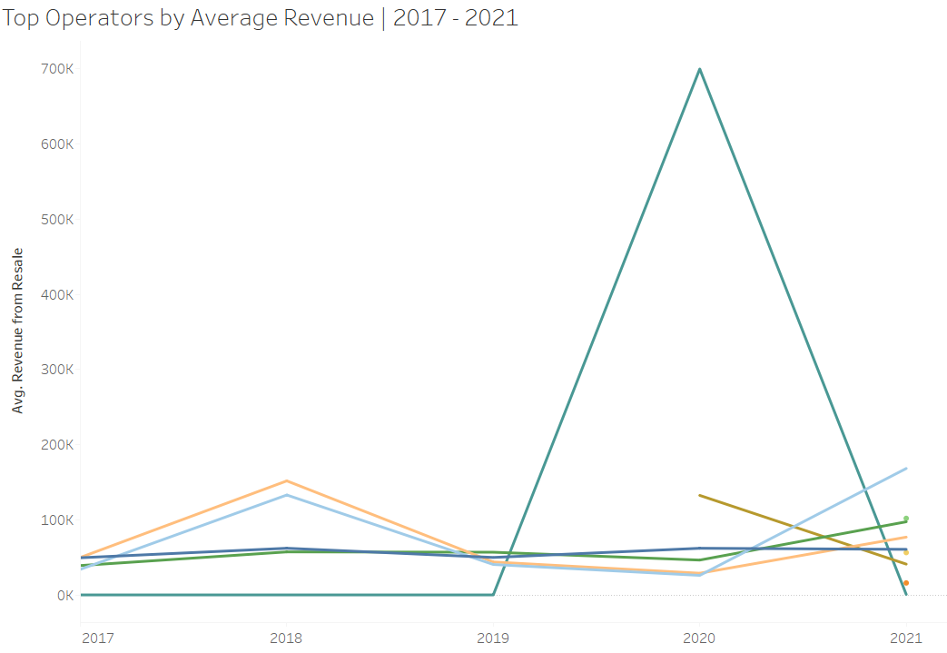
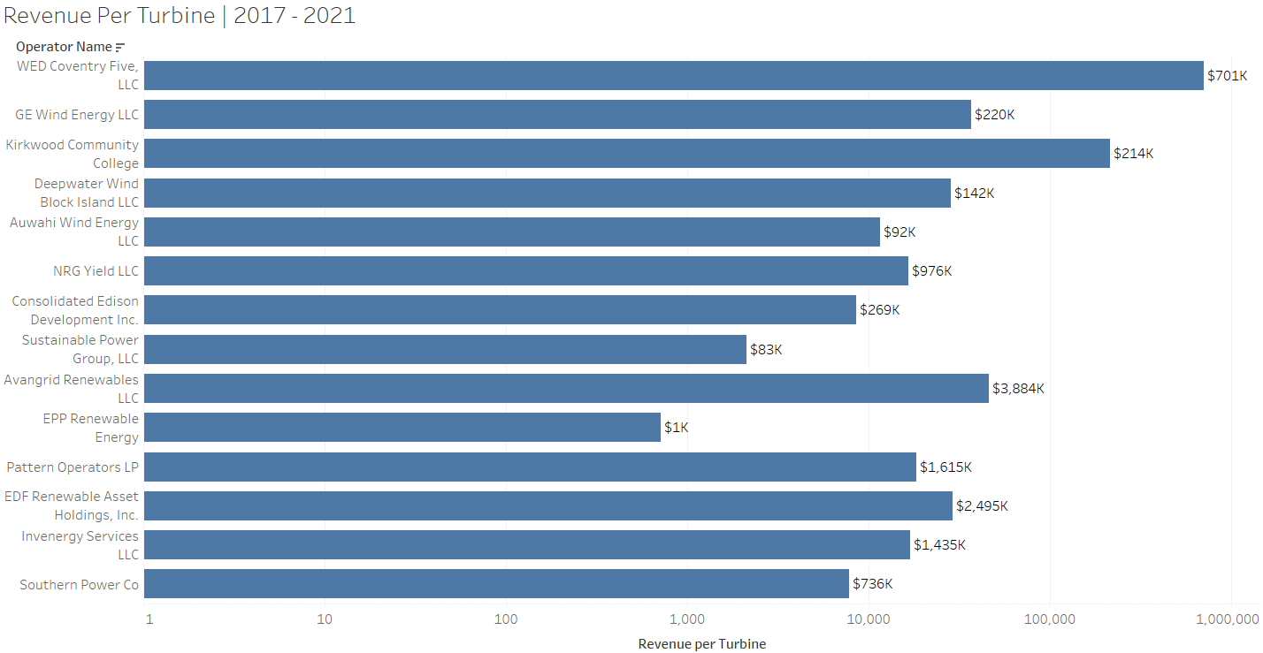
PB
Wind Turbine Market | Revenue
Revenue Trend of the Turbine industry
Revenue Per Turbine, per Operator
Most operators saw an increase in Revenues in 2018, followed by decline through 2019 and 2020, and increasing trends in 2021. Exception to this trend are for WED and Caithness shepherds.

Slide 9
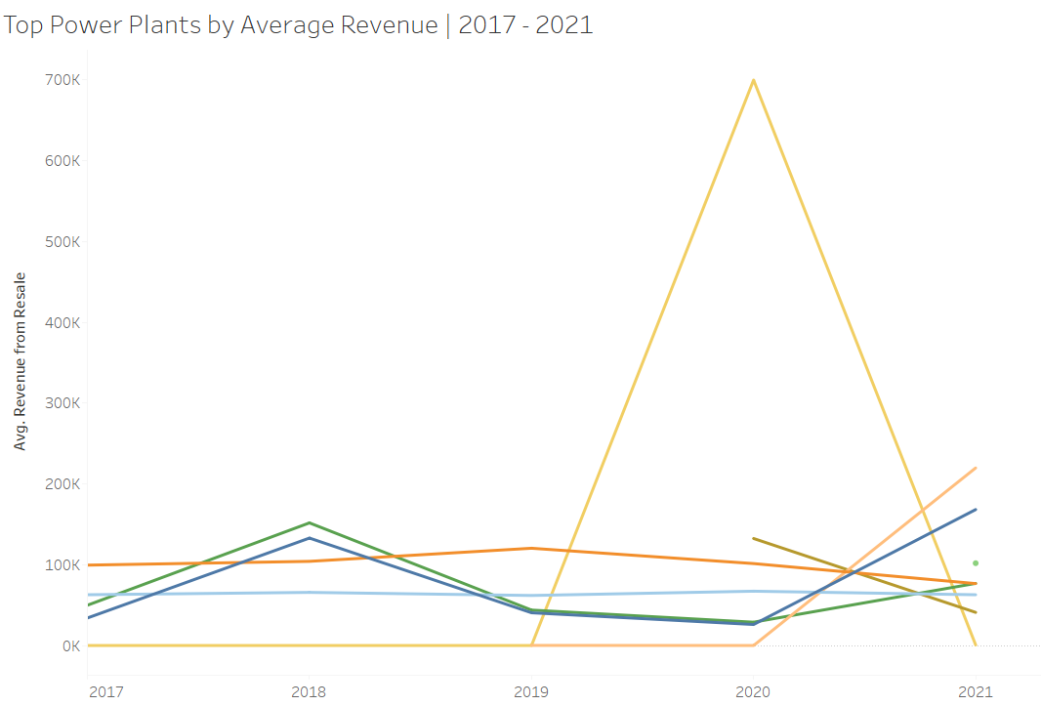
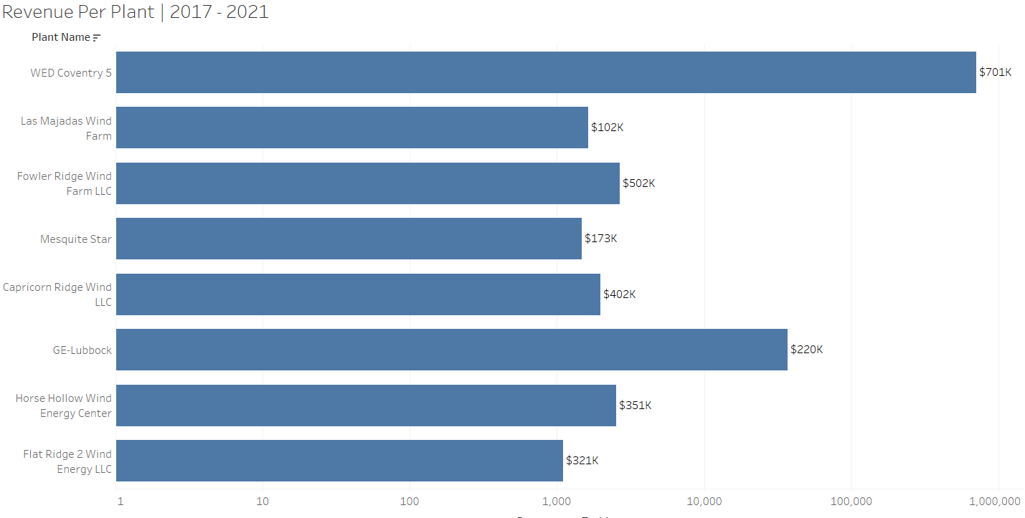
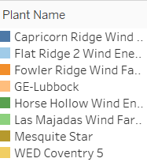
PB
Power Plant | Revenue
Plant Revenue Trend

Slide 10
Operators Analysis

Slide 11
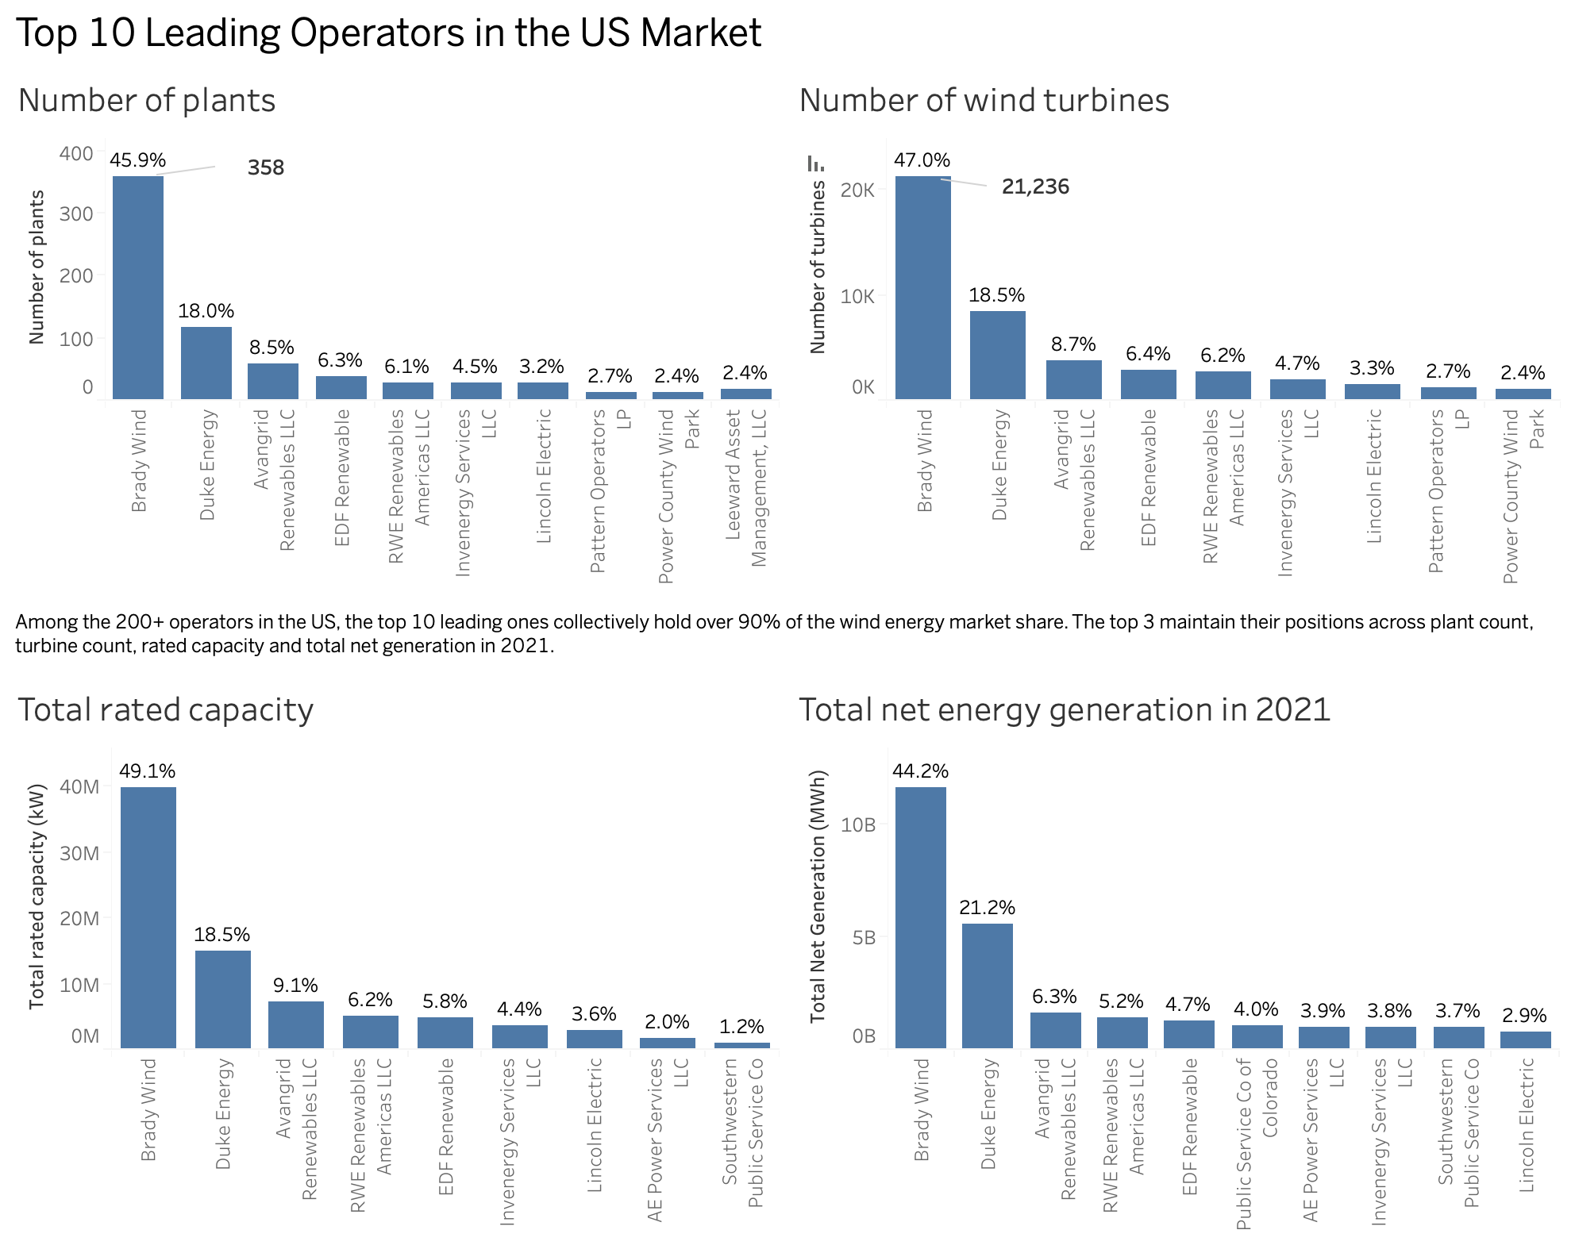
HL
Operators Analysis | Key players in the market
Top operators at a snapshot
Number of operators: 213
Top 10 operators collectively command more than 90% of the market share.
Top 3 operators maintain their positions across various metrics, including plant count, turbine count, rated capacity, and total net generation in 2021.

Slide 12
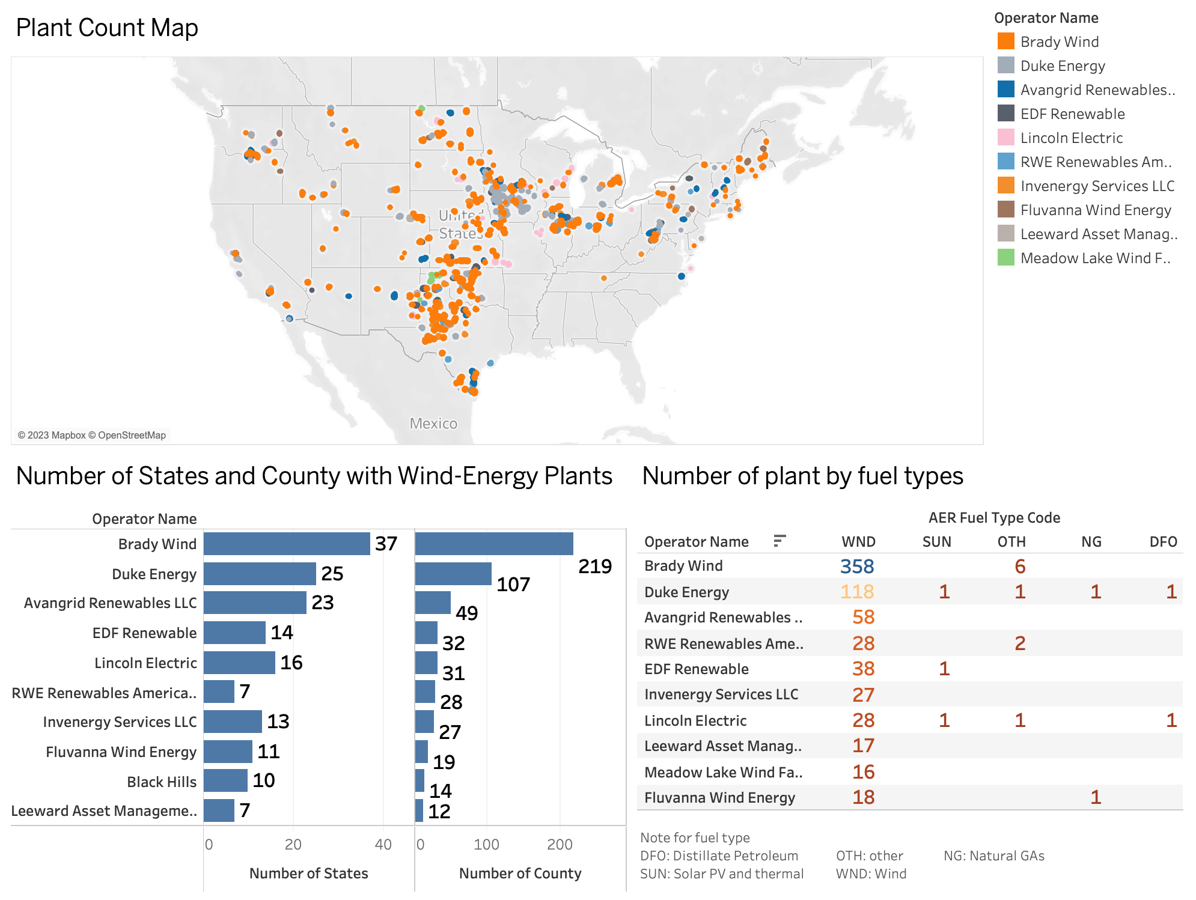
HL
Operators Analysis | Key players in the market
Top operators by plant presence
Brady Wind dominates the US market by number of plants and presence in state – present in 37 states, 219 counties.
Duke Energy are second market leaders and have a more diverse portfolio than Brady Wind – operates plants in all fuel types (e.g. Wind, Natural Gas, Solar PV, thermal and distillate petroleum)

Slide 13
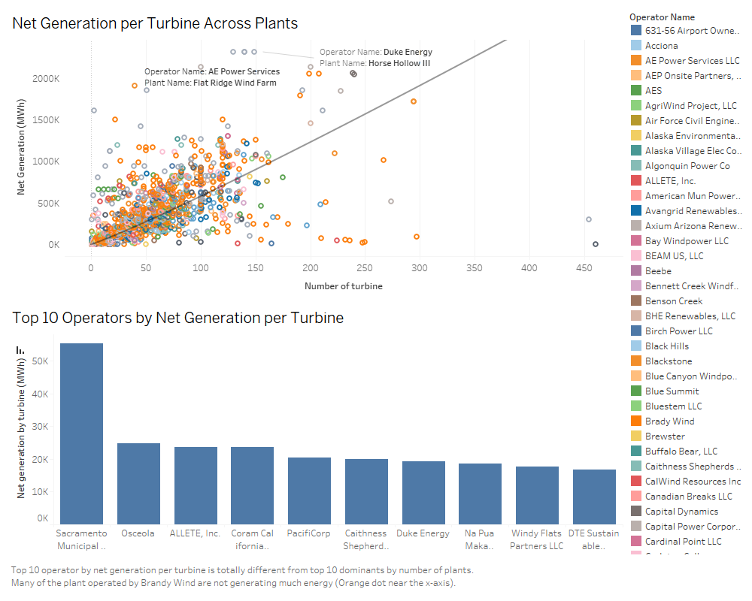
HL
Operators Analysis | Key players in the market (cont.)
Top operator – highest net generation to no. of turbines by project
The operators with the highest level of net generation and lowest number of turbines by projects are :
Duke Energy (Hollow II and Horse Hollow Wind Energy Project)
Brady Wind
Public Services Co of Colorado (Rush Creek II project)
AE Power Services (Flat Ridge Wind Farm)
Top 10 operators – net generation by no. of turbines
The operators with the highest level of net generation per turbine are:
Sacramento Municipal
Osceoia
Allete

Slide 14
Understanding Wind Turbines

Slide 15
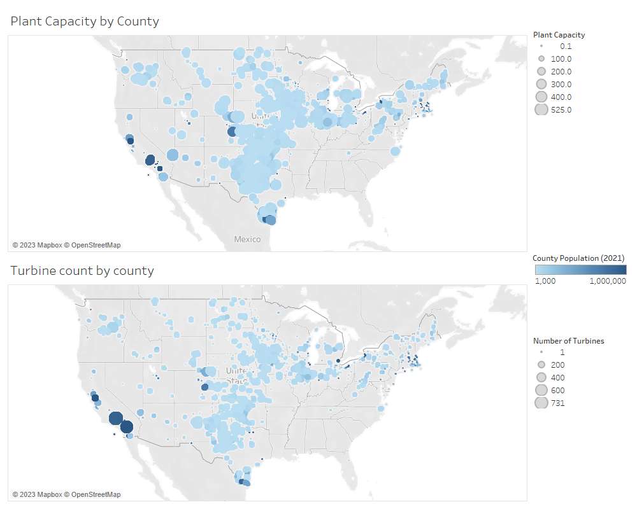
MN
Understanding Turbines | Geographical Location
Turbine Locations
Most large plants are not close by to largely populated counties.
Typical for there to be many plants in an area/county
Would like to ascertain if there is a drop off in energy if it travels large distances, but beyond our scope.

Slide 16
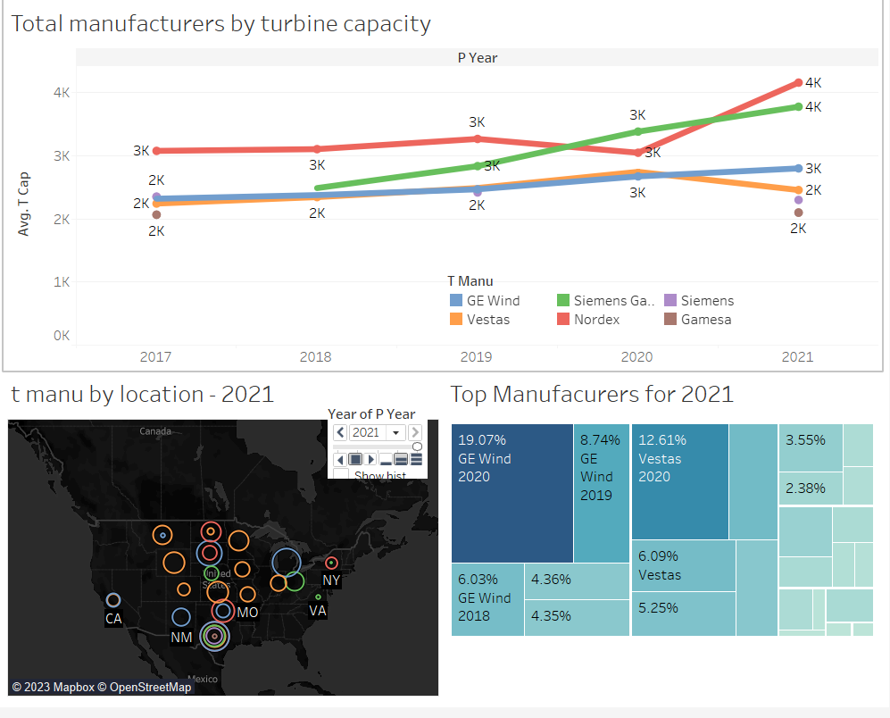
PB / MN
Turbine Manufacturer Analysis

Slide 17
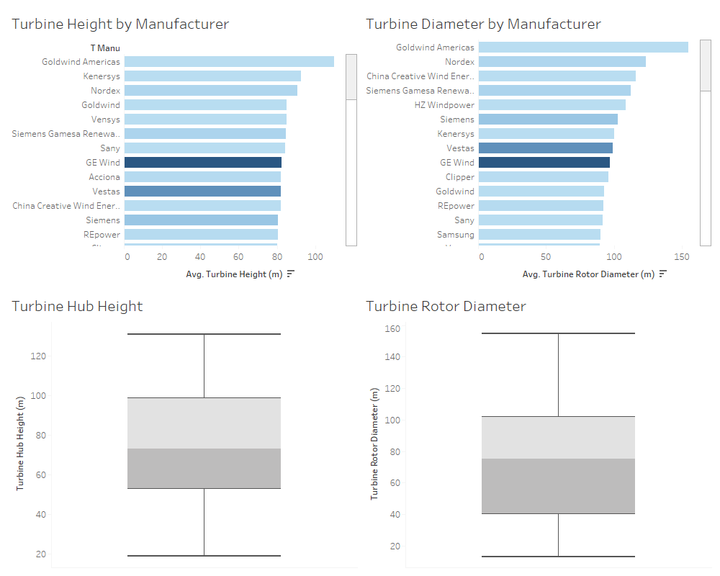
MN
Understanding Turbines | Attributes (cont.)
Turbine Attributes
Turbines can differ wildly in the attributes, even across manufacturers.
Turbine Hub Height and Rotor Diameter are evenly distributed over the ranges found, indicating that no individual height or Diameter is default better, and should be constructed based on the needs of the plant.
GE Wind and Vestas are the manufacturers with the greatest share of turbines in the space by a large margin.
On average turbines have a Hub Height of about 75m and Rotor Diameter of about 80m.
Hub Height is used to catch more wind and a greater Rotor Diameter will generate more electricity.

Slide 18
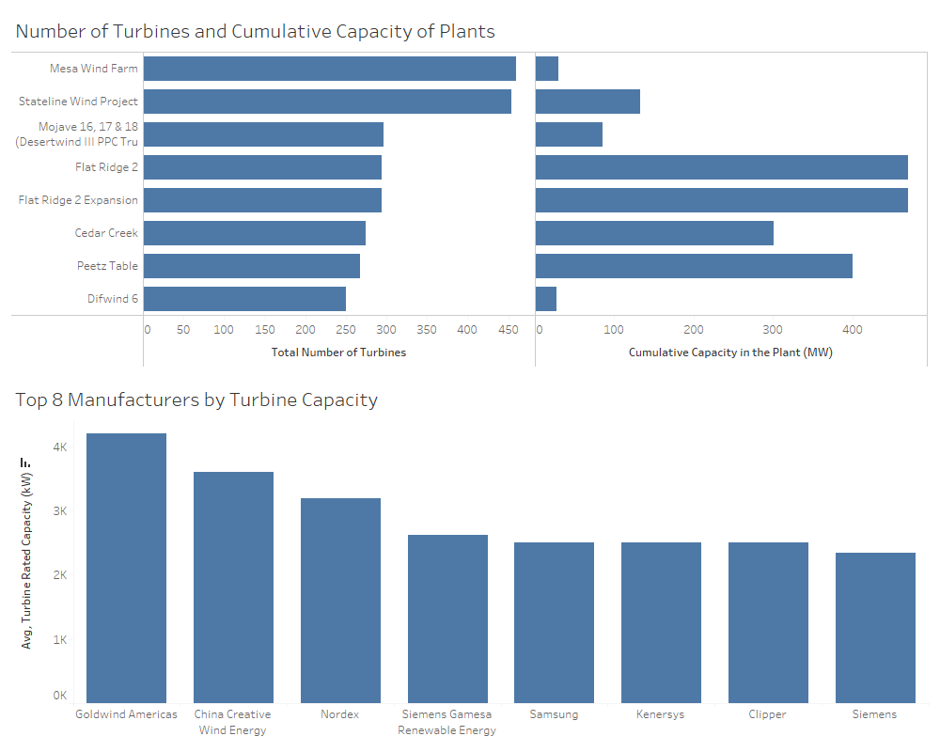
MN
Understanding Turbines | Attributes of turbine plants
Turbine Attributes Capacity
Largest plants have over 250 turbines generating electricity.
Plant energy Capacity and number of turbines aren't necessarily correlated. Can't immediately expect a plant that has a large number of turbines to have a large Capacity.
If looking at purchasing a plant by looking at avg Turbine Capacity, Goldwind Americas would be the first choice.

Slide 19
SL
Manufacturer Analysis | Key players in the market (cont.)
Manufacturers on Wind Turbine in the US | 2017 - 2021
Wind turbine manufacturer | No of turbines from 2017 – 2021
There were 4 manufacturers of wind turbines in the US in 2017 - 2021. Vestas and GE Wind dominates the manufacturing market.
Vestas and GE Wind are the top players respectively and together, they make up over 80% of the total manufacturing market share from 2017 – 2021. This also represents 14,434 units of turbine.
In 2017 and 2018, Vestas was the market leader by a small margin, however, GE Wind overtook Vestas’ position by a significant in 2019 and 2020.
Vestas
Nordex
GE Wind
Siemes-Gamesa
No. of Turbines
Notes:
Slide 19: When looking at key players in the manufacturing market
There were 4 manufacturers of wind turbines in the US in 2017 – 2021 with Vestas and GE Wind dominating the manufacturing market.
Vestas and GE Wind are the top 1 and 2 player respectively and together, they make up over 80% of the total manufacturing market share from 2017 – 2021. This also represents 14,434 units of turbine.
In 2017 and 2018, Vestas was the market leader by a small margin, however, GE Wind overtook Vestas’ position by a significant margin in 2019 and 2020.
In 2021, these two market players significantly reduced their output – GE Wind by c. 78.2% and Vestas by c. 60.0% from 2020 to 2021.

Slide 20
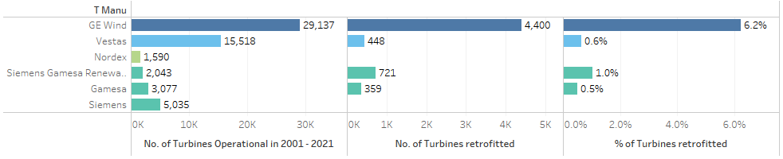
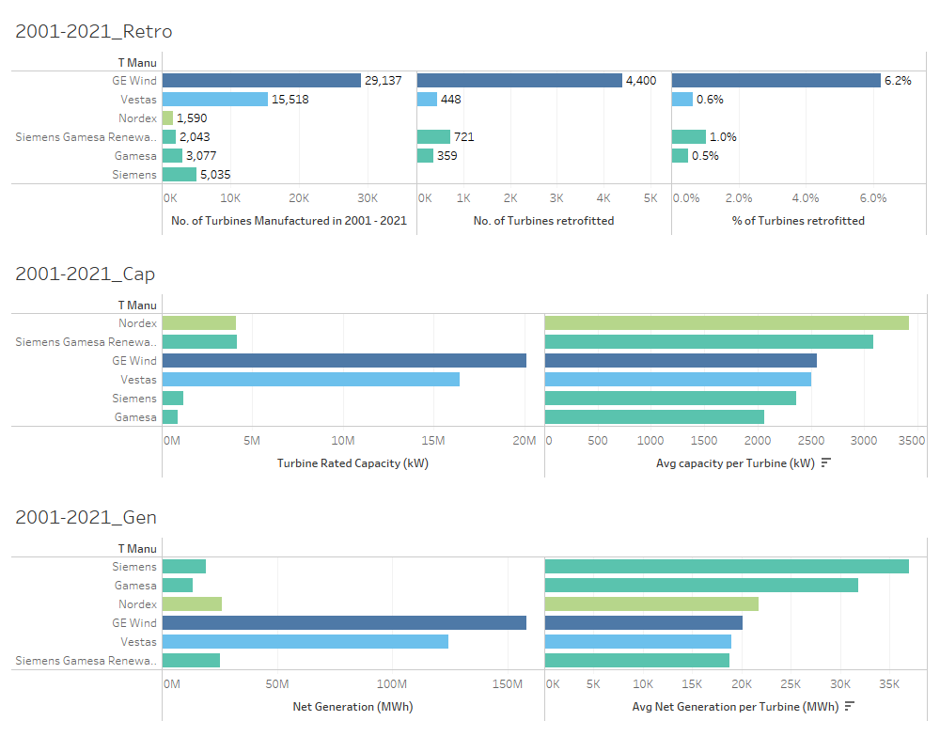
SL
Manufacturer Analysis | Key players in the market (cont.)
Retrofit by Manufacturer | Turbines Manufactured in 2001 - 2021
Quality of Turbines by Manufacturer
Several metrics for quality are explored:
Percentage of Retrofit
Average Capacity by Manufacturer
Average Net Generation by Manufacturer
The typical useful life of a turbine is 20 years and we have therefore elected to analyse turbines operational from 2001 to 2021 with respect to retrofit.
Wind turbines manufactured by GE Wind have the highest percentage of retrofit.
When looking at Capacity and Net Generation by Manufacturer
Turbines manufactured by Nordex, Siemens Gamesa and GE Wind have the highest average turbine capacity.
Turbines manufactured by Siemens Gamesa have the highest average net generation per turbine.
Turbine Capacity by Manufacturer | Turbines Manufactured in 2017 - 2021
Net Generation by Manufacturer| Turbines Manufactured in 2017 - 2021
Notes:
Slide 20: Additionally, we have looked at the quality of the turbines manufactured
Several metrics have been used as a proxy to measure quality:
Percentage of Retrofit
Average Capacity by Manufacturer
Average Net Generation by Manufacturer
The typical useful life of a turbine is 20 years and we have therefore elected to analyse turbines operational from 2001 to 2021 with respect to retrofit.
Our assumption is that higher levels of retrofit is an indicator of poorer quality (and it will require money or investment to do the retrofit)
Wind turbines manufactured by GE Wind have the highest percentage of retrofit at 6.2%.
When looking at Capacity and Net Generation by Manufacturer
Turbines manufactured by Nordex, Siemens Gamesa and GE Wind have the highest average turbine capacity -
Turbines manufactured by Siemens Gamesa have the highest average net generation per turbine.

Slide 21
Future Outlook

Slide 22
SL
Future Outlook | policies and reforms
Targets for green energy in the US.
There has been significant support by the US government for renewable energy and this has been a key factor in driving growth in the industry.
Federal tax credits for production and investment
Federal grants and loan programs including the Department of Agriculture and the Department of Energy
State and local government tax credits to help financing projects
Renewed efforts by the federal government are in play and are projected to further expand the renewable energy market
Ambitious goals set by the Biden-Harris Administration: mandates to achieve 100% carbon pollution free electricity by 2023 and net zero emissions from federal procurement by 2050
Efforts to improve permitting and regulatory processes for renewable energy projects and investments in US supply chain and manufacturing
At COP27, climate adaptation was a key focus area, with a particular push towards pledges from nations across the world to commit towards a renewable energy target.
US TARGET
80%
Renewable energy generation by 2030
Notes:
Slide 22:
When looking into the future and what the future state looks like it is important to consider:
There has been significant support by the US government for renewable energy and this has been a key factor in driving growth in the industry.
Federal tax credits for production and investment
Federal grants and loan programs including the Department of Agriculture and the Department of Energy
State and local government tax credits to help financing projects
There are Renewed efforts by the federal government are in play and are projected to further expand the renewable energy market
Ambitious goals set by the Biden-Harris Administration: mandates to achieve 100% carbon pollution free electricity by 2023 and net zero emissions from federal procurement by 2050
At COP27, climate adaptation was a key focus area, with a particular push towards pledges from nations across the world to commit towards a renewable energy target.

Slide 23
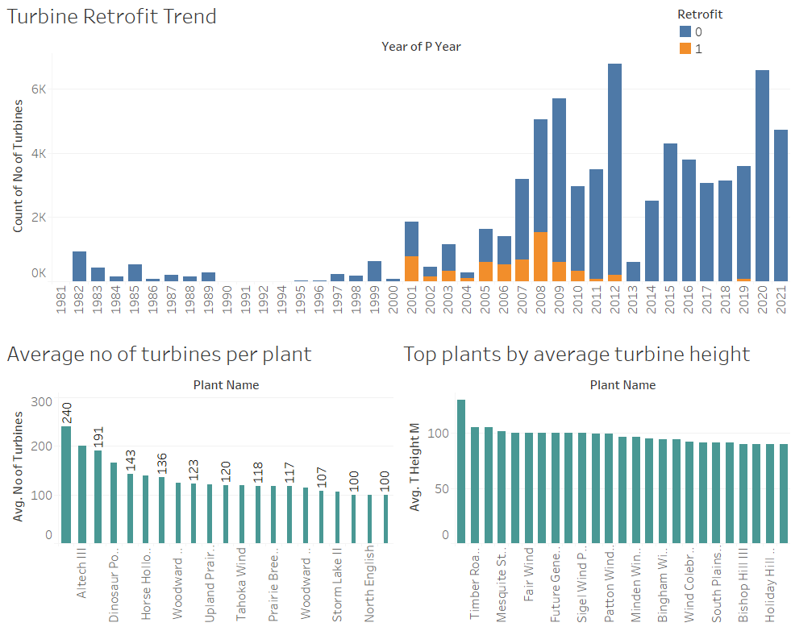
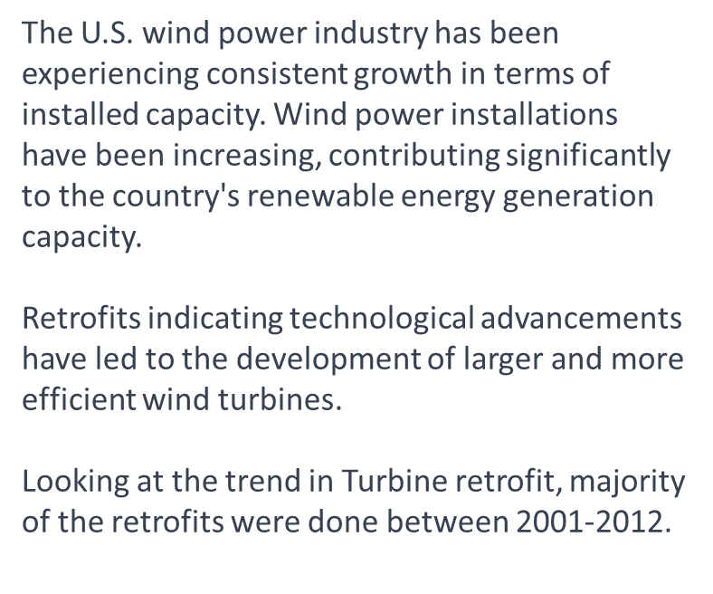
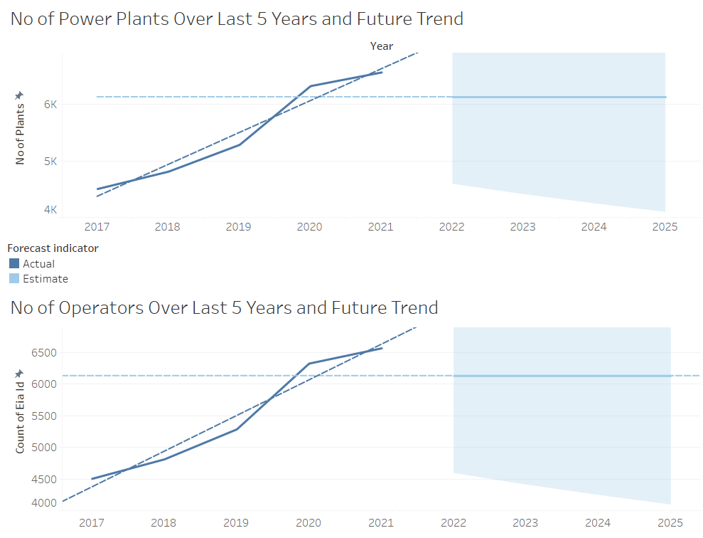
PB

Slide 24
Recommendation

Slide 25
MN
Recommendations
Recommend approaching Duke Energy to invest in
Operate in 25 states, 107 counties
2nd largest operator in term of size owns over 18% of the plants in the country
One of the top ten leading operators by net generation per turbine
Operating different fuel-type plants
Very high average plant efficiency to turbine ratio
Recommend approaching Brady Wind to invest in
He owns over 45% of the plants in the country, and 32% of the total capacity.
Also largest net energy generator by a large margin, and more energy generated translates to a larger return.
Good average plant efficiency, of over 7000 MWh per turbine
Moderate-high plant efficiency to turbine ratio
Other small plants to acquire:
WED Conventry 5 ($701k in revenue per turbine) and GE Lubbock ($220k in revenue per turbine).

Slide 26

Reflection
Lessons learned:
Everyone has different working styles – sometimes completely different to yours so you have to navigate/compromise
Really important that all members are familiar with the data before moving ahead
Triple check schedule – we ran out of time at the end for probably the most crucial point
Lessons we are still learning:
Analyse with intent – how do things fit into the bigger picture and the story we are trying to tell.
Not to get too hung up on details. A better high level overview is more beneficial than a more detailed one that is unfocused.
Getting everyone onto the same page and aligned in our goals

Slide 27
Background Information – current global state
US Wind Turbine Market | focus and objective
50% of campaigns crowdfunded through Kickstarter were successful. On average, $8,628 was pledged per successful campaigns.
COP27 and other reforms

Slide 28
Background Information – US current state
COP27 other reforms
National renewable energy targets
Energy by source (insert viz)
Energy by renewable energy source (insert viz)
Viz – current state of the US market
Viz – evolution of the US wind turbine market over time (2017 – 2021)

Slide 29
Snapshot
Number of wind turbines
Top N operators
Top N manufacturers(?)
Total capacity
Net Generation
No. of plants (27 states)
Revenue, Cost, Profitability of the market

Slide 30
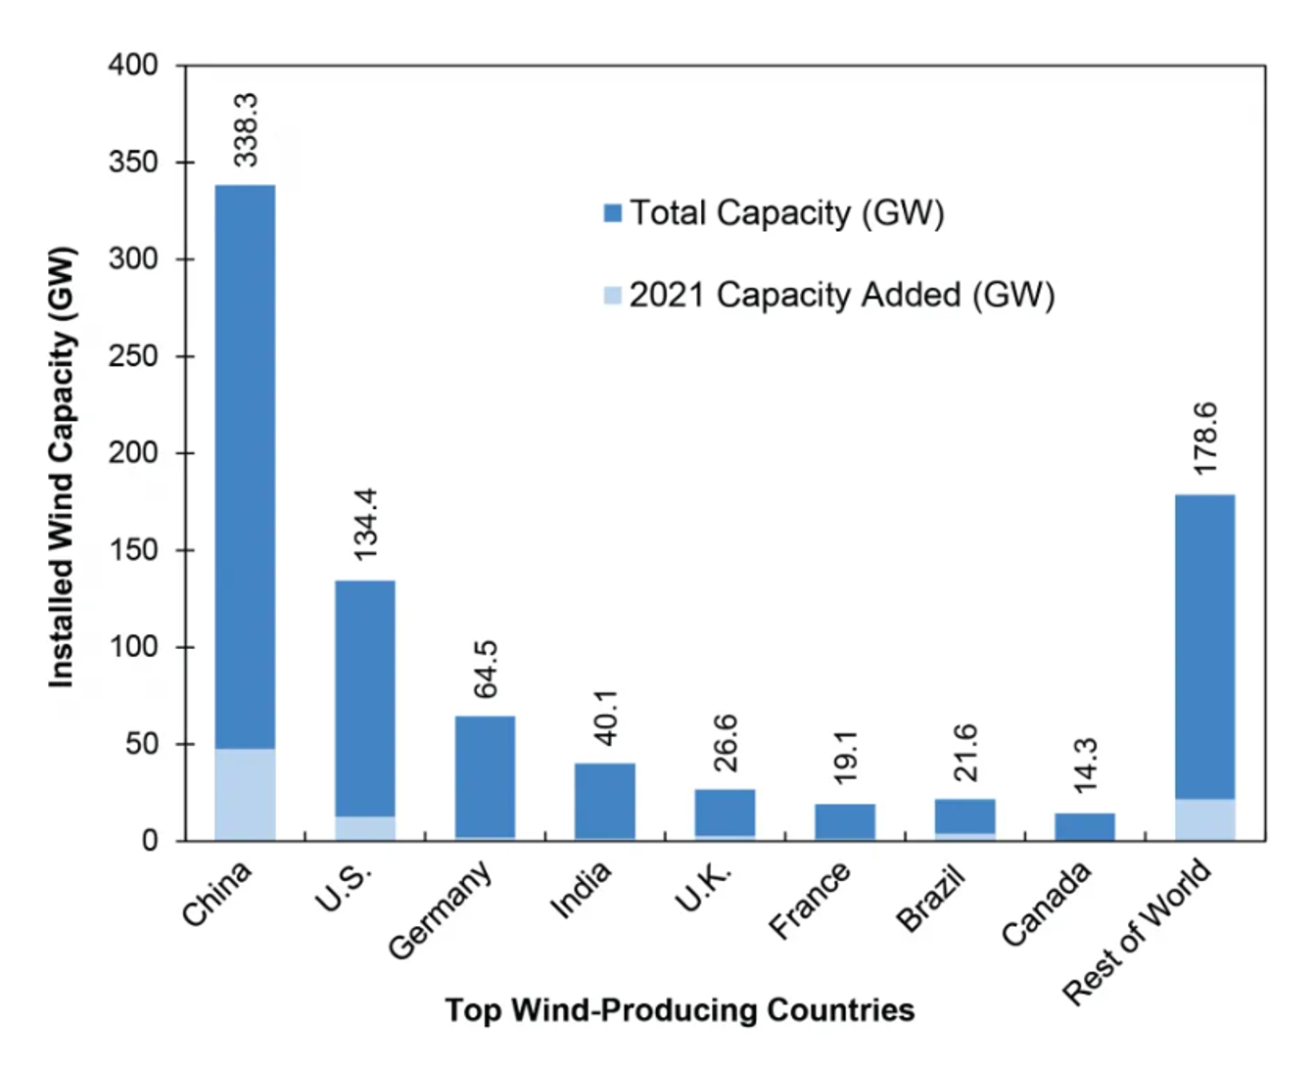
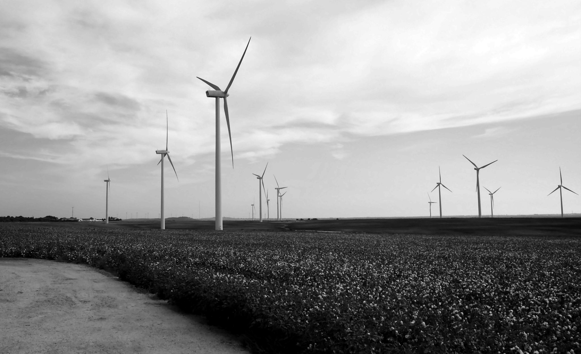
Wind Energy Industry Trends
A 2015 study by the U.S. Department of Energy found wind could provide 20% of U.S. electricity by 2030 and 35% by 2050.
In 2021, 9.2% of U.S. electricity was generated from wind energy.
Average annual wind speeds of 6.5m/s or greater at 80m are considered commercially viable.
High wind speeds yield more power Wind speeds are slower close to the Earth’s surface and faster at higher altitudes.
The average hub height of modern wind turbines is 90 meters.
More than 60,000 turbines are installed in the U.S., with cumulative capacity of 134.2 GW.
Texas (35,049 MW), Iowa (12,006 MW) are the leading states in total installed wind capacity.

Slide 31
Analysis – operators (to clarify: operators only in the wind energy market or diversity)
Number of wind turbines (split by Onshore vs. Offshore Wind Turbines – WT And WS)
Operator’s market (key operators, snapshot figures, total net generation by operator)
Geographical presence by operators (Top N)
Revenue/Profitability by operators

Slide 32
Analysis – Attributes of wind turbines
Dimension of turbines
Manufacturers of turbine (total capacity by manufacturer)
Capacity of turbines by x
Maintenance – retrofit (more retrofit = bad = poorer quality) – defining what quality means
Net generation of turbines

Slide 33
Recommendation
Which operator?
- Top 3/5?
Reasons for recommendation
- At least 3 metrics (revenue per unit, cost per unit, profitability, net generation, capacity: no. turbine ratio, net operation per turbine, low cost per unit of electricity generation, type of turbines)
Geographical location of plants by operator?
Is the operator involved in the market for other energy source? Diversity or specialisation?

Slide 34
Funding * to clarify (consider in the recommendation)
Potential companies to approach to fund (which financier)
Depends on our metrics and recommendation
Financier that specialises in [x] particular space?
Debt covenants alignment with financier? E.g High energy output for low number of turbines, low cost per unit of electricity generation

Slide 35
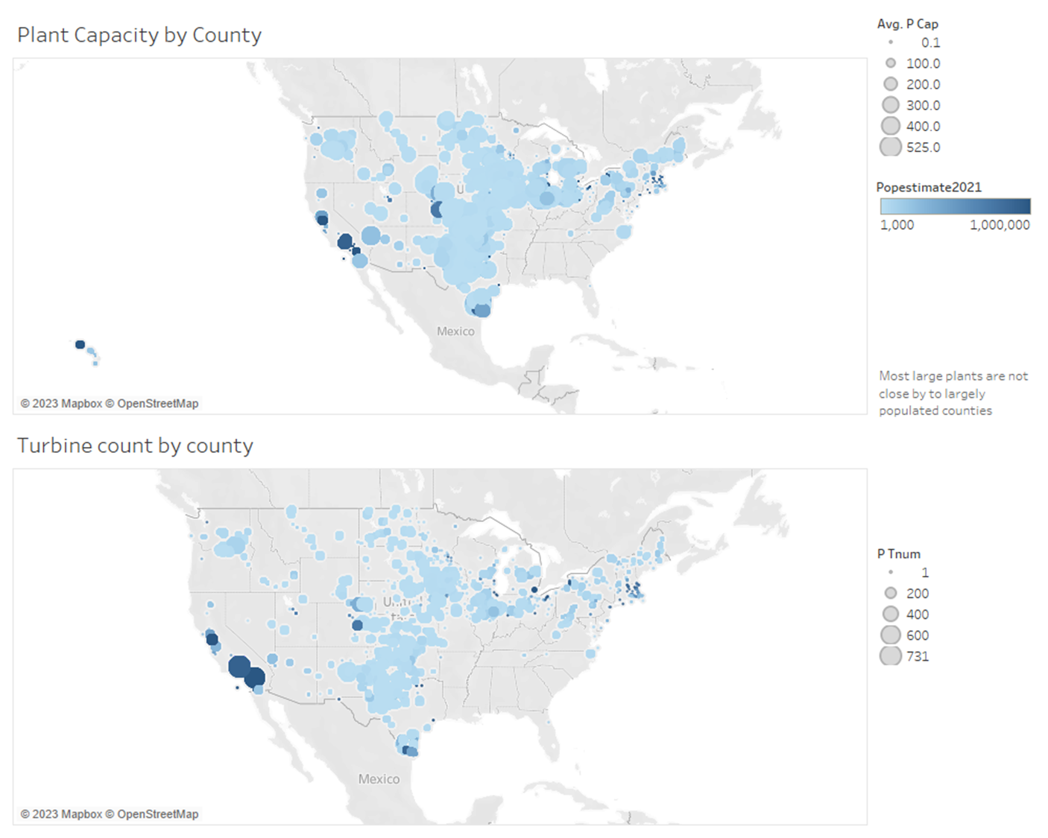
[7] Plant to population breakdown
(2021 census population)

Slide 36
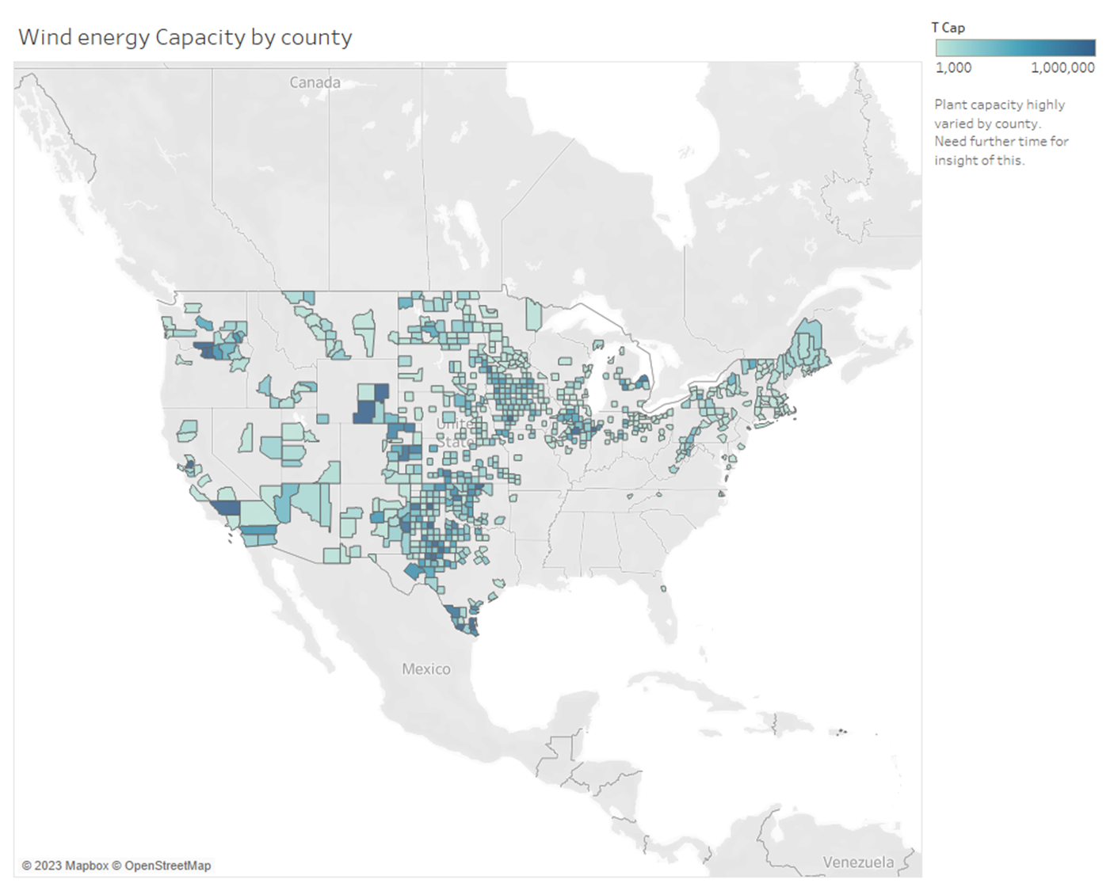
County to capacity Comparison

Slide 37
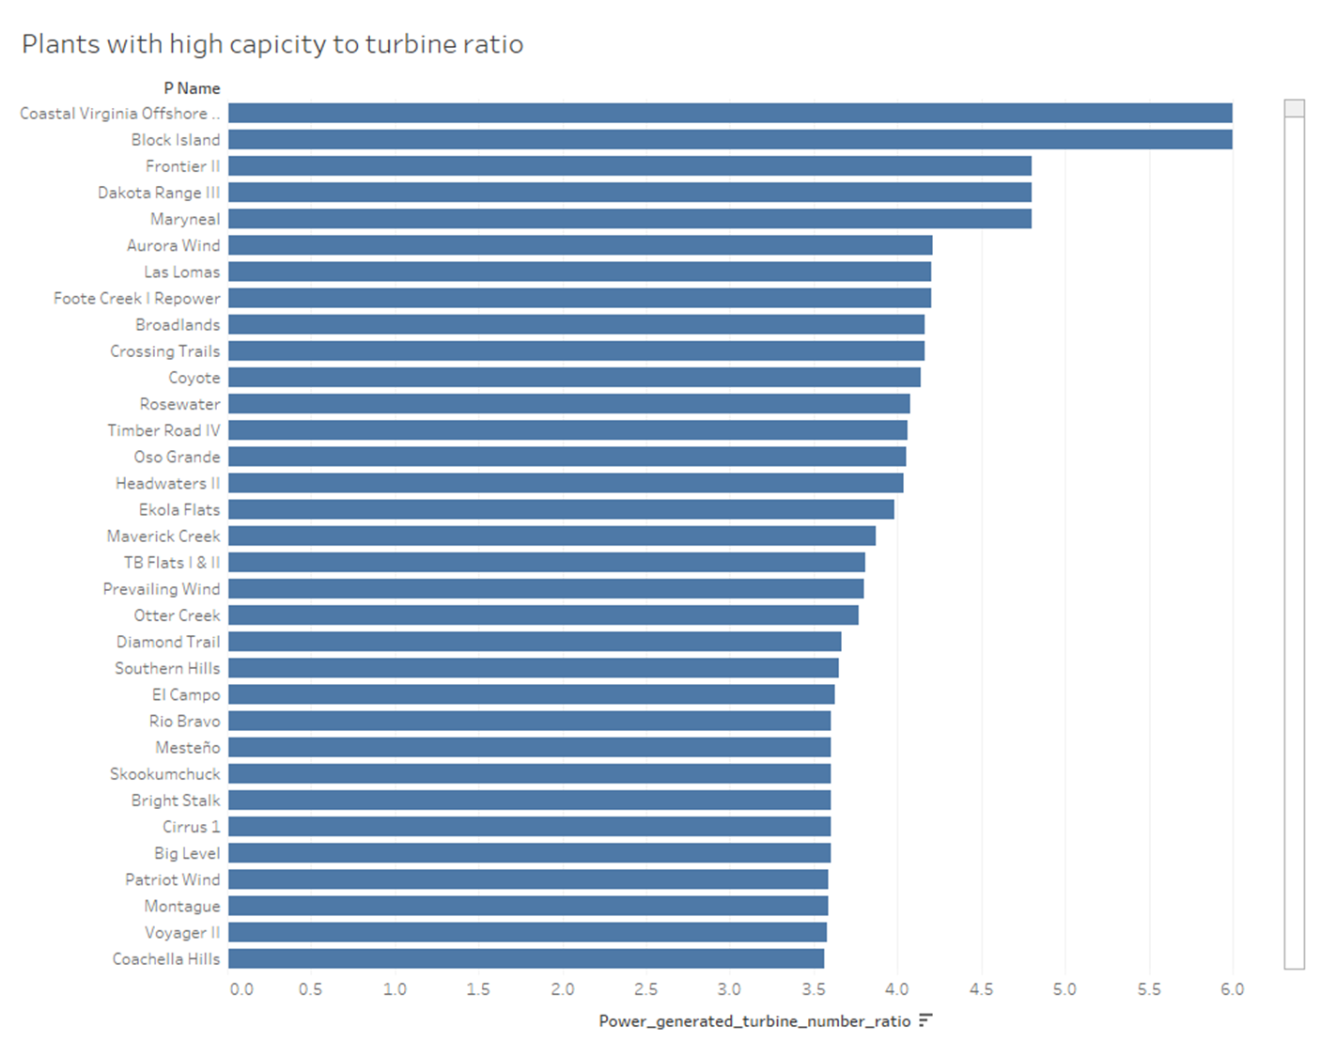
Desirable plants to invest into

Slide 38
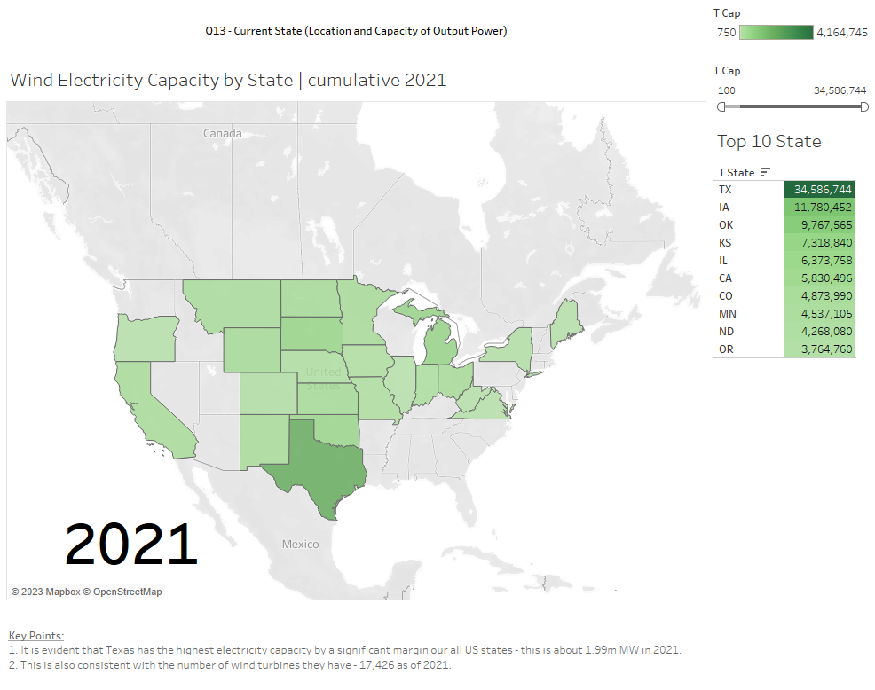
13. Location and output power – current state (total capacity by state in 2021)

Slide 39

13. Location and output – how total output has evolved from 2017 – 2021

Slide 40
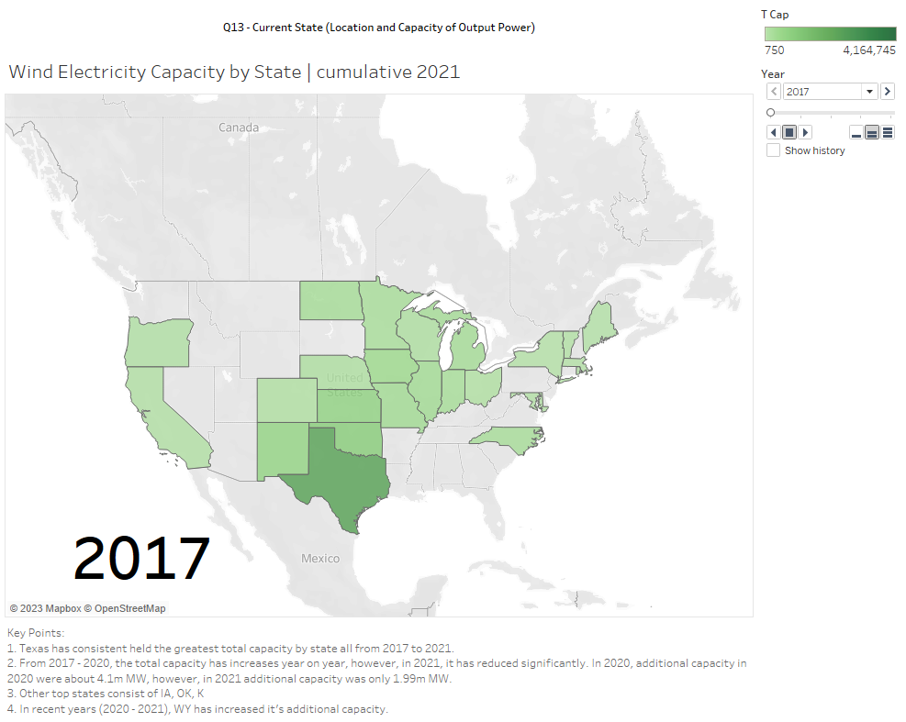
13. Location and output – how YoY output has evolved from 2017 – 2021

Slide 41
3. Current state of the wind power market (global and US)
Global Market
The global renewable energy market size was valued at USD 1.1 trillion in 2022 and is projected to grow at a compound annual growth rate (CAGR) of 16.9% from 2023 to 2030 (source: https://www.grandviewresearch.com/industry-analysis/renewable-energy-market)
In 2022, the global solar power segment accounted for the largest marketshare (30.62%) and is expected to grow at a significant rate over the forecast period.
The hydropower segment accounted for a significant revenue share of 16.87% in 2022.
Wind power and bioenergy segments are also expected to increase steadily over the forecast period.
China leads the wind energy market with an installed capacity of 221 GW folloed by the US. With 96.4 GW, Germany with 59.3 GW, India with 35 GW and Spain with 23 GW.
US Market
In 2022, renewables are estimated to constitute 22% of the US electricity generation and experts predict the percentage for 2023 will be even higher. As for total renewable consumption (Industrial, Transportation, Residential, Commercial), renewables accounted for 12.7% as the main sources of those consumptions.
There is no doubt that improvements in renewable energy infrastructure within the US, the world’s second-largest polluter behind China, are a key breakthrough that can put the world on the right path.

Slide 42
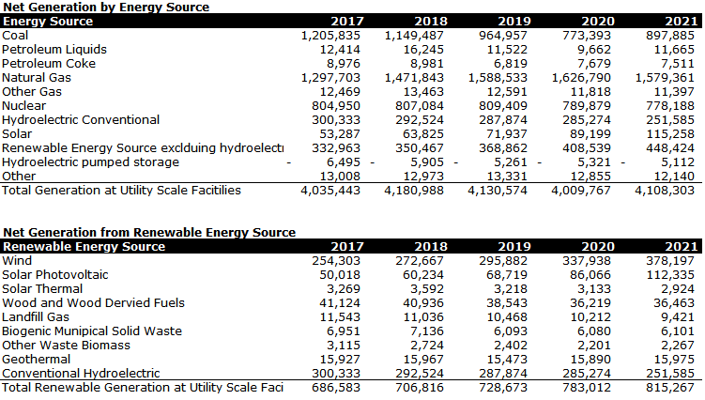
3.Trends in the US market – all source / renewable energy source

Slide 43
3. Future outlook
Global
At the implementation-branded COP27, IRENA and its partners from Denmark and the Global Wind Energy Council (GWEC) made great strides through the launch of the Global Offshore Wind Alliance. Australia, Belgium, Colombia, Germany, Ireland, Japan, the Netherlands, Norway, Portugal, the United Kingdom, and the United States joined the Alliance. IRENA estimates that by 2030, offshore wind could supply 24 per cent of total power needs globally.
US
The Biden administration plans to eliminate fossil fuels as a form of energy generation in the U.S. by 2035. The White House set out a target of 80% renewable energy generation by 2030 and 100% carbon-free electricity five years later.
With 79% of total U.S. energy production still coming from fossil fuel sources as of 2021, achieving this goal will require billions of dollars in investments
As directed by President Biden’s Executive Order 14008, Tackling the Climate Crisis at Home and Abroad, the Interior Department has partnered with other federal agencies to increase renewable energy production on public lands and waters —including a commitment to deploy 30 gigawatts of offshore wind by 2030, 15 gigawatts of floating offshore wind by 2035, and a target goal of permitting at least 25 gigawatts of onshore renewable energy by 2025.

Slide 44
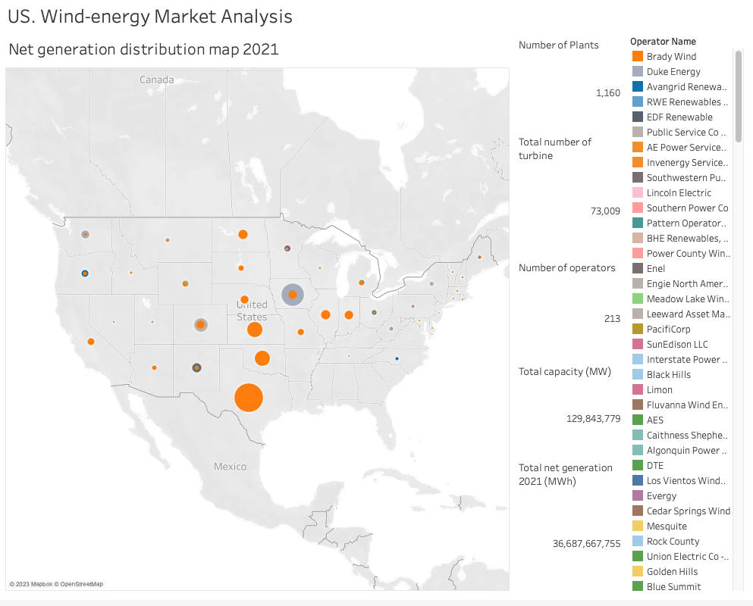

Slide 45
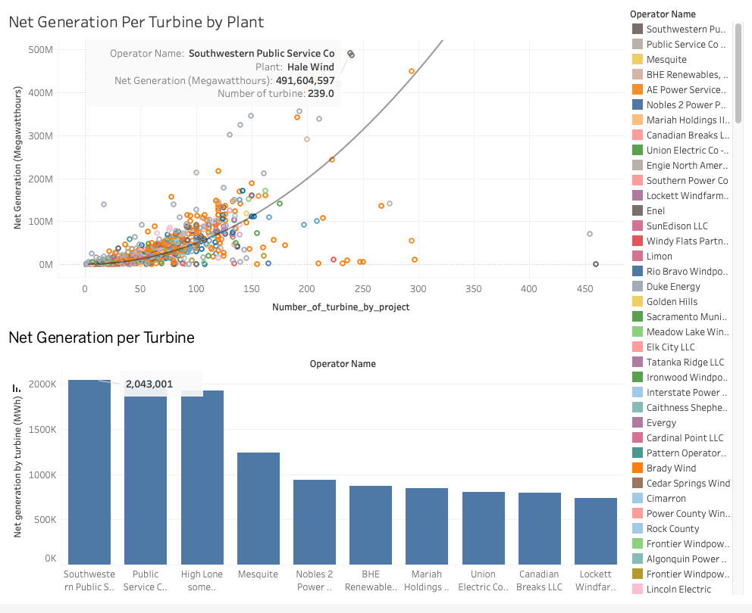
Q14-16

Slide 46
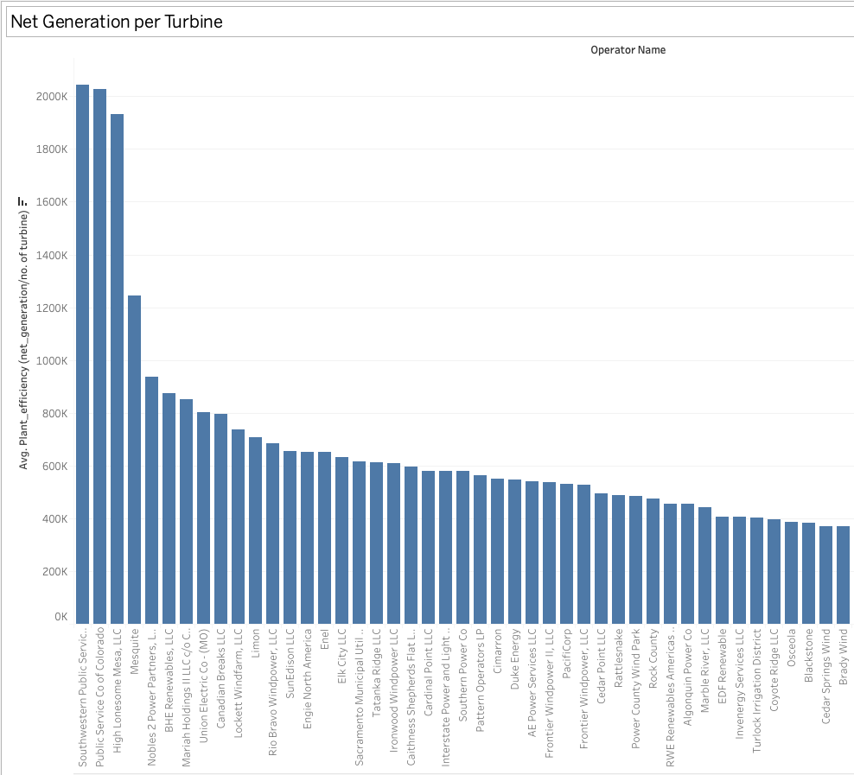

Slide 47
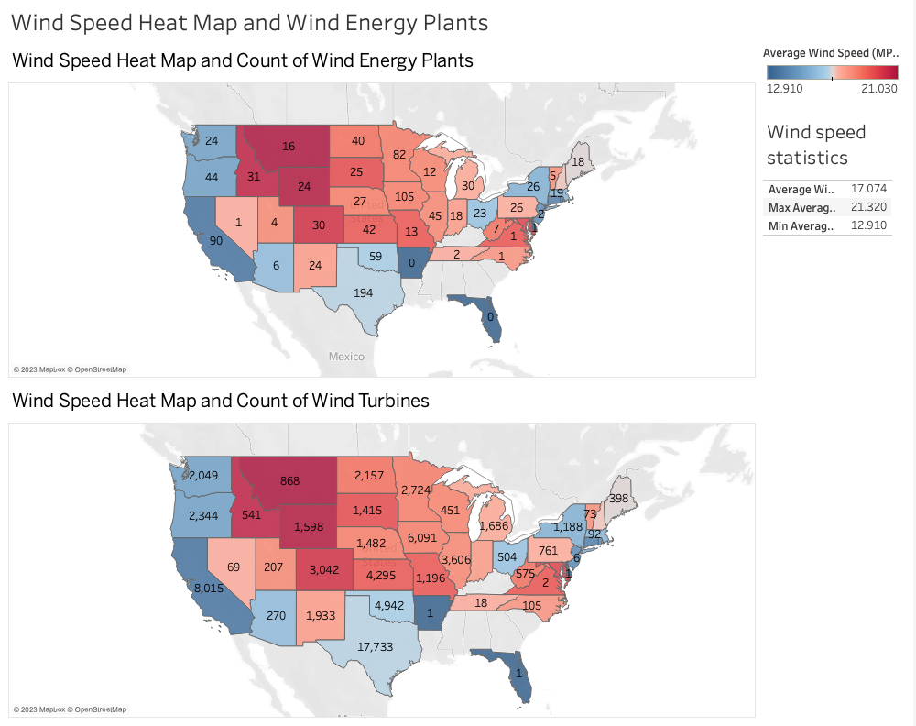
Q15

Slide 48
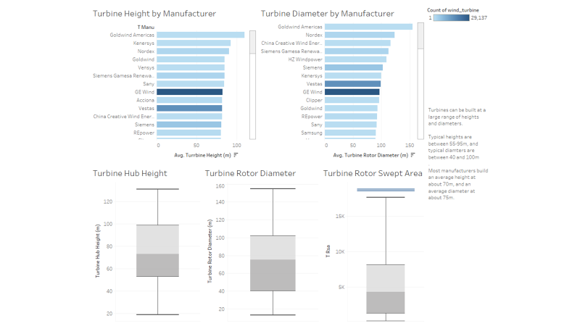
8

Slide 49
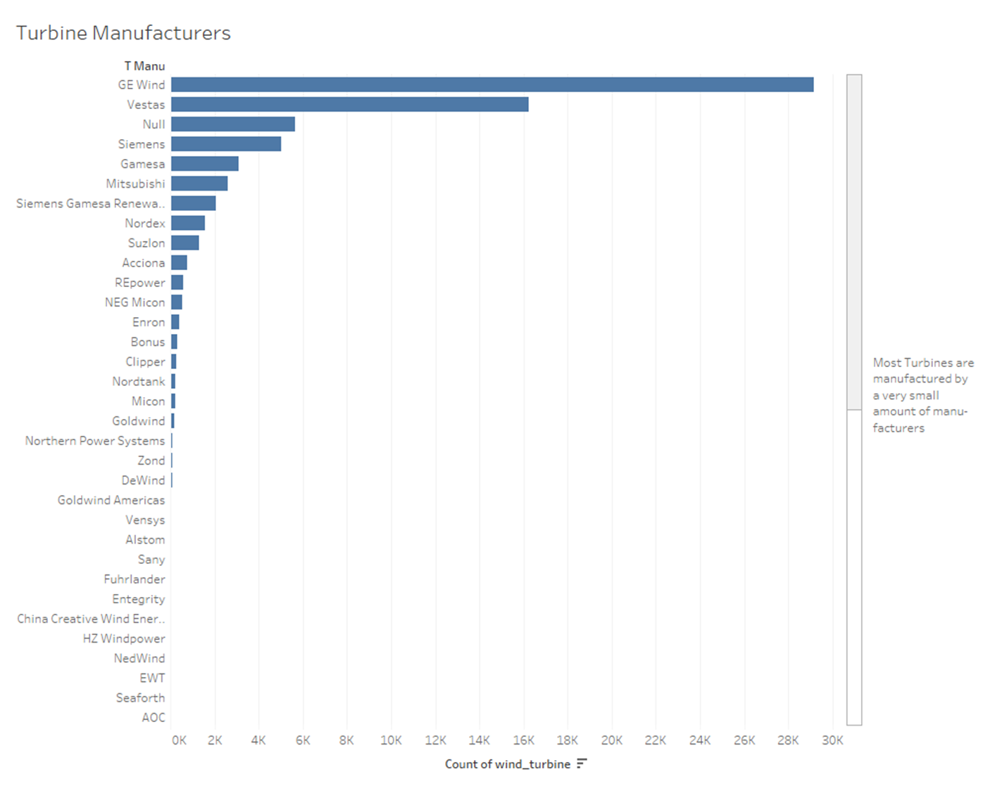
8 cont.

Slide 50
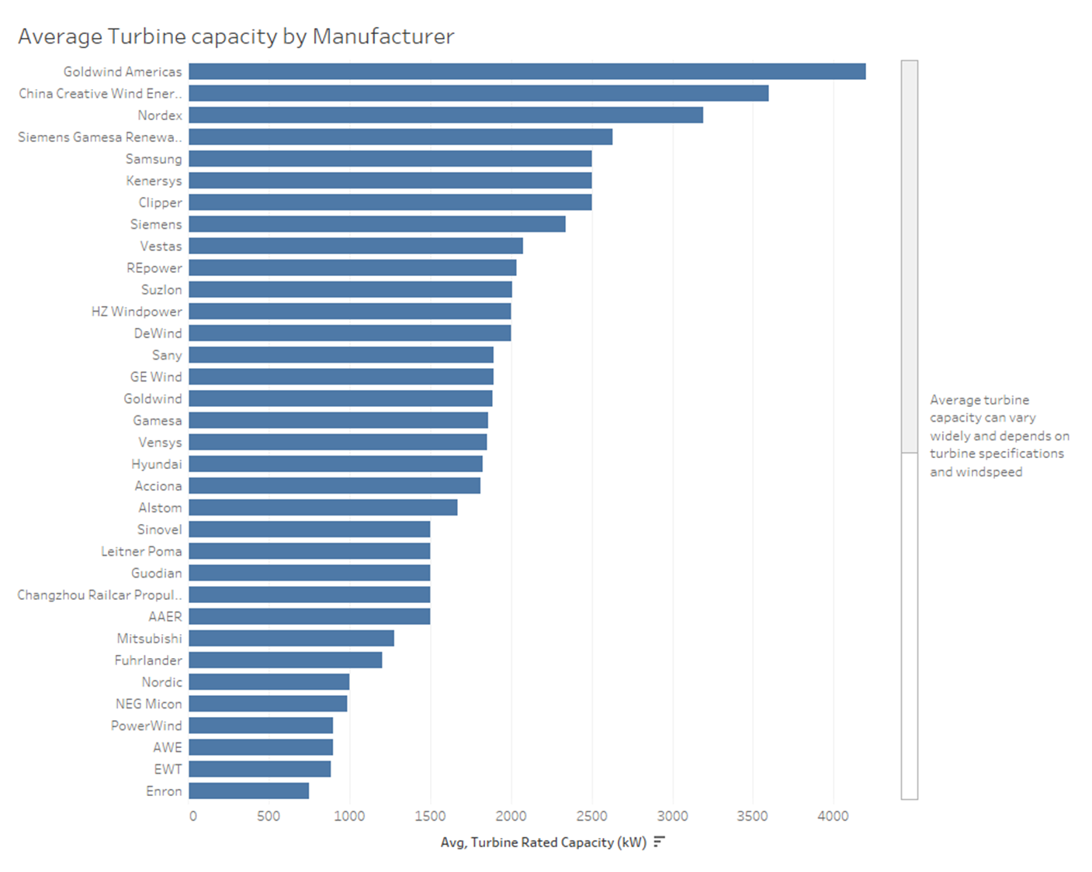
8 cont.

Slide 51
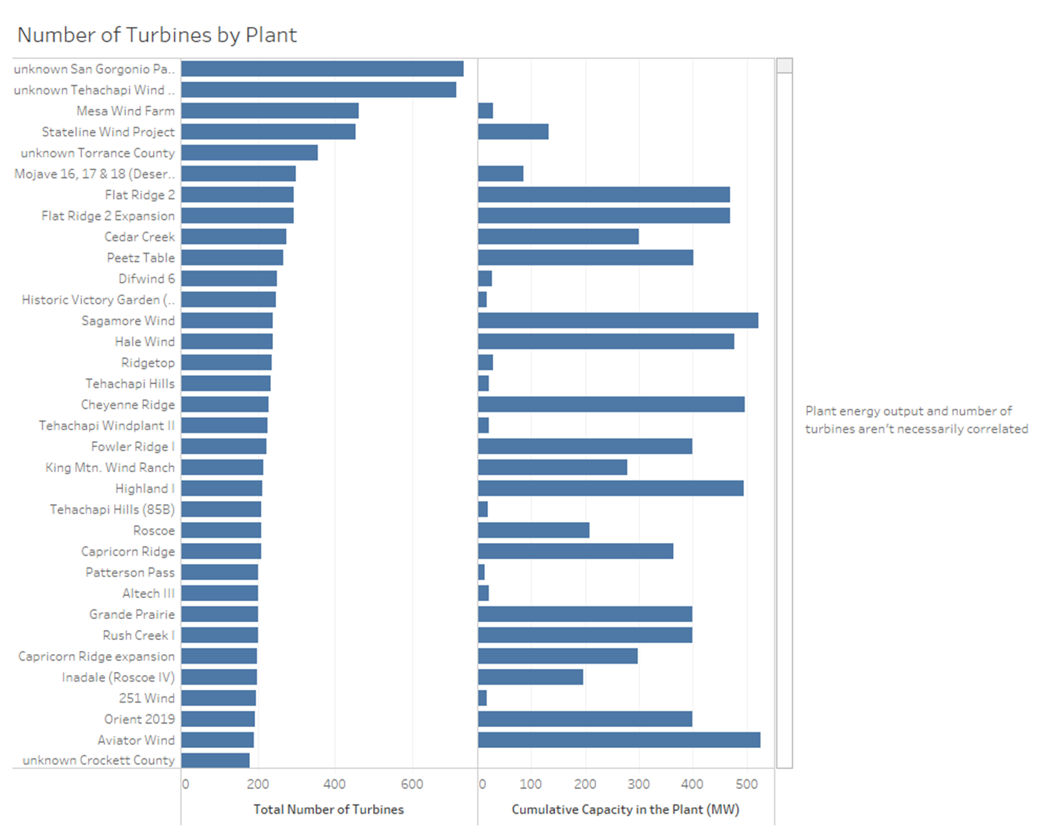
8 cont.

Slide 52
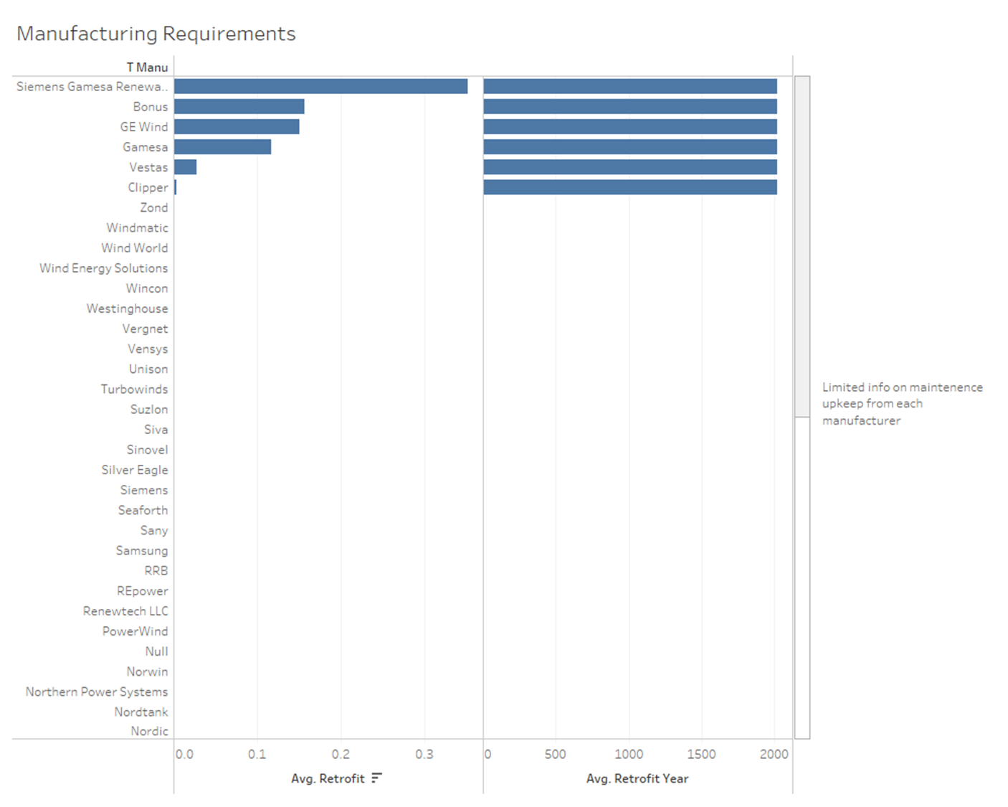
8 cont.
Notes:
State limitations of analysis (retrofit)

Slide 53
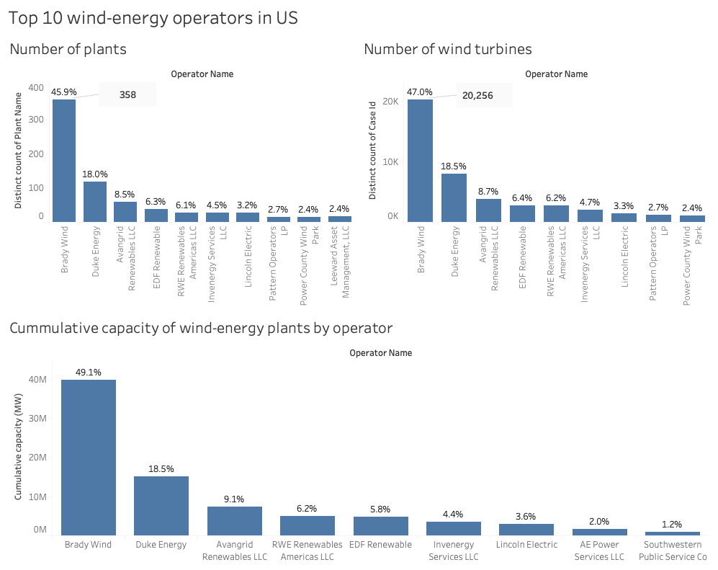
10. Top 10 wind-energy operators in US

Slide 54
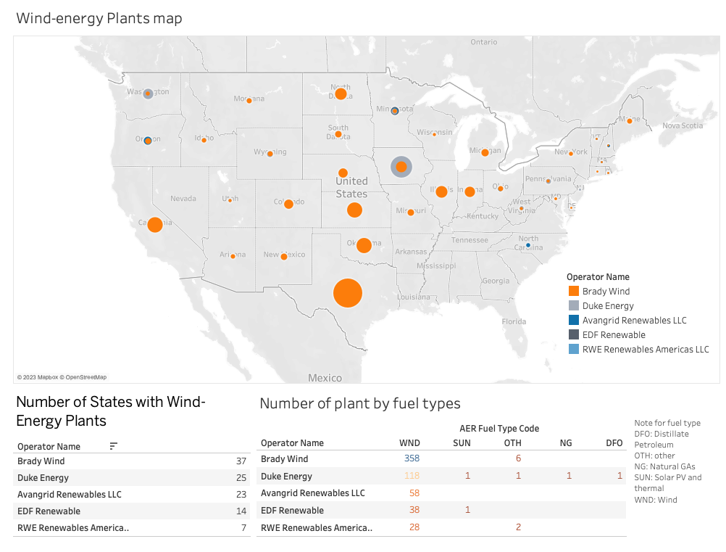
10. Top 5 Operators by most Potential Company to Invest

Slide 55
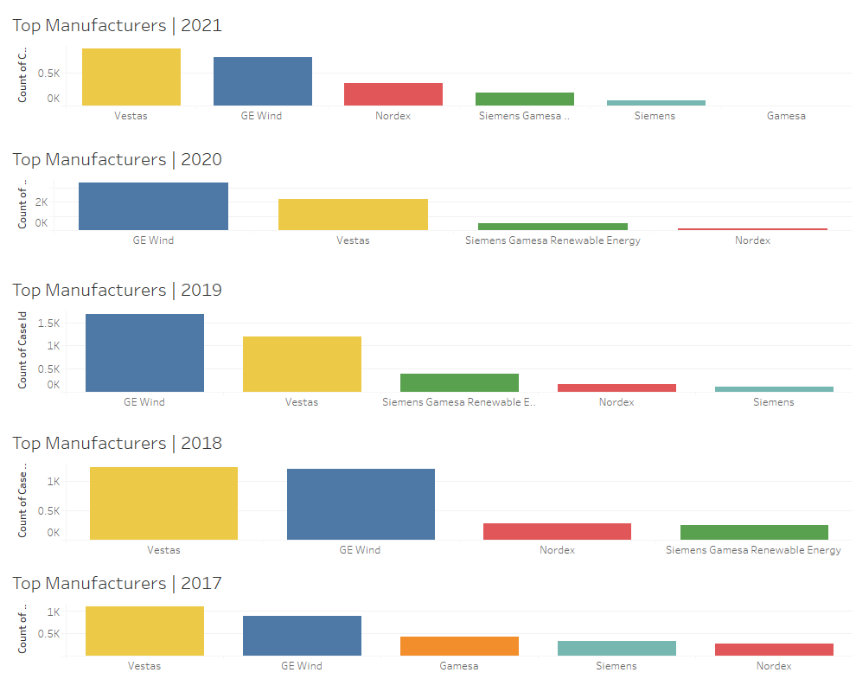
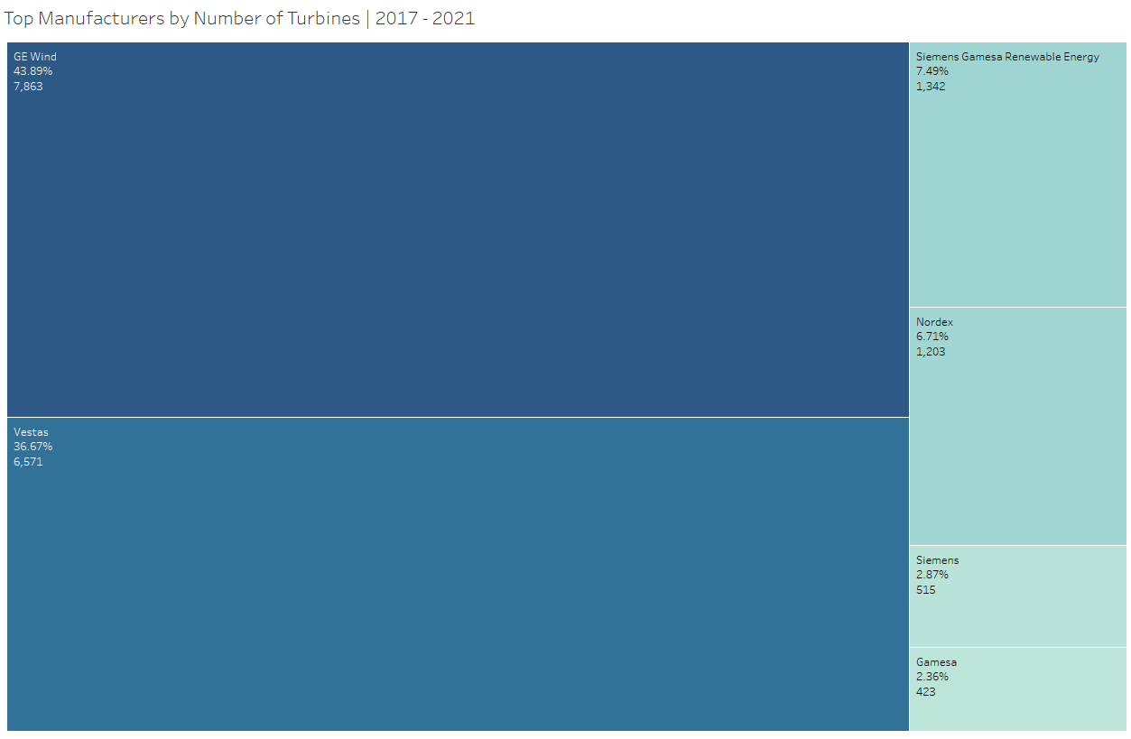
12. Top Manufacturers | 2017 - 2021
- From 2017 to 2021 (the last 5 years), there has been 6 manufacturer in the US wind turbine industry: vestas, GE Wind, Gamesa, Siemens and Nordex and Siemens Gamesa
- The top players are Vestas and GE Wind respectively and together, they both make up 80.56% (or 14434 units of Turbine) of the US marketshare.
- In 2017 and 2018, Vestas dominated the manufacturing market with GE Wind being a close second industry lead. GE Wind overtook Vestas in 2019 and 2020, however, Vestas rebounded and dominated the industry in 2021.

Slide 56
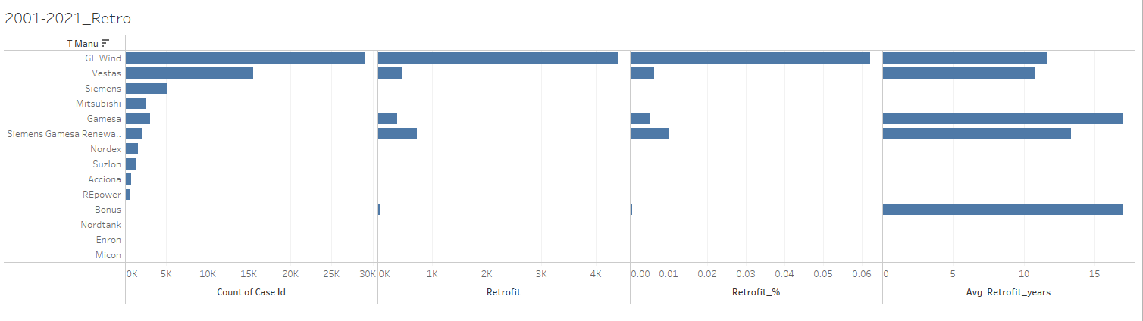
12. Quality of turbines by manufacturer (retrofit)
- The typical lifespan of a wind turbine is 20 years and therefore, for the purposes of this analysis, we have looked at data from 2001 – 2021.
- I have elected to use Retrofit as a proxy for measuring the quality of the turbines.
- From 2001 to 2021, only GE Wind, Vestas, Gamesa, Siemes Gamesa and Bonus have reported any retrofit activities.
- GE Wind has engaged in the highest activity of retrofit by count of turbines with 6.2% of its turbines retrofitted.
- Vestas has also engaged in retrofit activities, however, only 0.6% of its turbines have been retrofitted.
- While we have taken the assumption that higher activity of retrofit indicates poorer quality (to confirm), it is also noted that retrofitting could also be an indicator of a turbine’s improvement to its useful life/quality (and ultimately required retrofitting)
Based on the data, Vestas has had the lowest average retrofit years (operational year – retrofit year) at 10.8 years. This is followed by GE Wind who has an average retrofit years of 11.7 years.
TBC – analysis on using output (electricity output) as a metric of quality.
Notes:
Total Capacity of Wind Power Generation – sense check – check with Ha. (128,000 MW) – wind turbine data set
Plant Operators to invest – any metrics? (no of turbines or capacity) – Rate of capacity: No. of Turbines - Ha – Coastal Cirginia at 6)

Slide 57
Operators Analysis | Key players in the market (cont.)
[x]
US Wind Turbine Market
Wind Energy Capacity by State | as at 2021 (kW)
There are 6 manufacturers of wind turbines in the US. Vestas and GE Wind dominates the manufacturing market.
Vestas
GE Wind
Nordex
Siemes Gamesa
Siemens
Gamesa

Slide 58
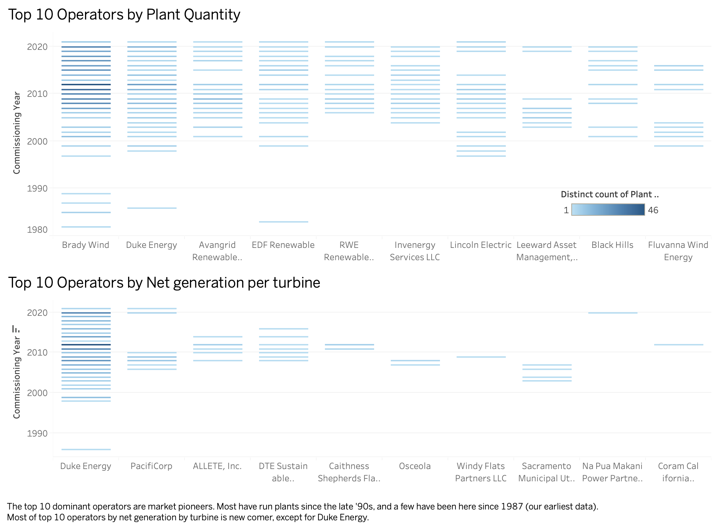
Operators Analysis | Key players in the market (cont.)
Plant count by Commissioning Year

Slide 59
